Slide 1
Evaluation of Semantic Search

Slide 2
Evaluation in Information Retrieval
The Cranfield experiments (1960s)
a small test collection of documents
a set of test queries
a complete set of relevance judgments
metrics to compare systems based on their output
Focus on the system aspects
Human factors are excluded, e.g. knowledge of judges, their understanding of the task, ability of users to formulate queries and understand the results etc.
Measuring effectiveness, not efficiency
Basis of TREC series of evaluations organized by NIST
Variety of tasks, query sets, collections, evaluation guidelines
Pooling approached was developed to scale up evaluation

Slide 3
Metrics
Precision: fraction of relevant documents within those retrieved
Recall: fraction of relevant documents that are retrieved

Slide 4
Metrics II.
Mean Average Precision
N documents
rel(r) is true if document at position r is relevant
P(r) is precision at position r

Slide 5
Metrics III.
Discounted Cumulative Gain (DCG)
Normalized DCG (nDCG)
Makes DCG comparable across queries

Slide 6
Entity Search Track at SemSearch 2010
Ad-hoc Object Retrieval task
Queries where the user is looking for a single real world object or a class of objects with certain characteristics
Pound et al. Ad-hoc Object Retrieval in the Web of Data, WWW 2010.
Originating at SemSearch’09
plenary discussion on the lack of evaluation in semantic search
Organizing committee
Harry Halpin, Daniel Herzig, Peter Mika, Jeff Pound, Henry Thompson, Thanh Tran Duc

Slide 7
Queries: what type?
Manual classification of queries in a real-world web search query log (N=300)
Limited direct value in solving attribute or relation queries
Caveats: users don’t enter these queries because they know we don’t solve them
Query type | Percent | Example
Entity query | 40.60% | starbucks palo alto
Type query | 12.13% | plumbers barcelona
Attribute query | 4.63% | zip code waterville maine
Relation query | 0.68% | chris brown rihanna
Other keyword query | 36.10% | nightlife barcelona
Uninterpretable | 5.89% | ŸÖÿ≠ÿ±ŸÖ

Slide 8
Queries
Yahoo releases a new query set
Part of the WebScope program: Yahoo! Search Query Log Tiny Sample, version 1.0
4.5k queries sampled from the US query log of January, 2009
Queries asked by at least three different users (privacy reasons)
Selected 42 entity queries of Yahoo dataset per methodology
“.44 magnum”, “butte, montana”, “american embassy nairobi”
Simplest form of queries to evaluate
40.6% of the queries in a web search query log
Added 50 “easy” queries from a Microsoft Live Search log
Queries that contain named entities per NER
Queries asked by at least 10 users
Final set of 92 queries

Slide 9
Data set
Same as Billion Triples Challenge 2009 data set
Blank nodes are encoded as URIs
A data set combining crawls of multiple semantic search engines
doesn’t necessarily match the current state of the Web
doesn’t necessarily match the coverage of any particular search engine
Final dataset

Slide 10
Process I.
Submissions via EasyChair
6 submissions, 14 runs
DERI, Delaware, KIT, UMass, L3S, Yahoo BCN
Pooling of results
Only top 10 results are evaluated
6158 unique queryID - URI pairs (12,880 potential)
Problem: some submissions contained duplicate results
Collecting triples for each result
All triples where the retrieved URI is the subject
Two methods: online index using MG4J and offline merging using Hadoop
Rendering result display
Problem: some of the retrieved URIs are only appear as object
5786 query-URI pairs evaluated

Slide 11
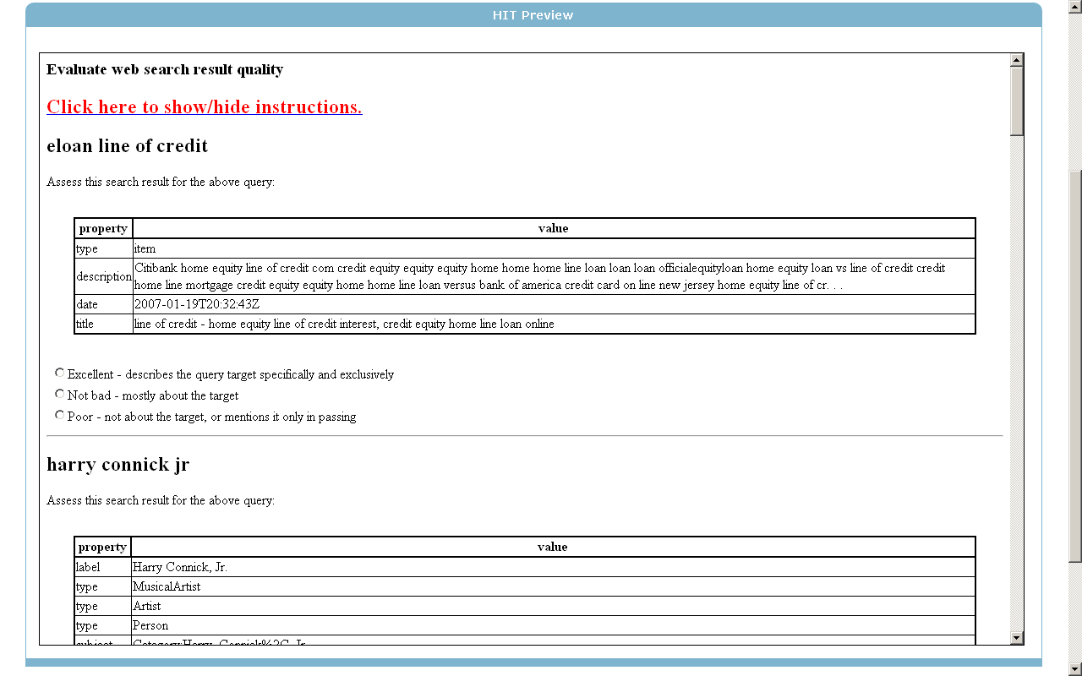
Result display

Slide 12
Process II.
Mechanical Turk
Query-result pairs packaged into batches of 12
10 real results
2 “fake” results: a gold-win and a gold-loose result
Each batch (HIT) judged by three judges
2 minutes time allotted and $0.2 per HIT
On average, Turkers were done in 1 minute
Two complaints that the time was too short
$6-$12 an hour
Execution monitored by Henry
Avg. and std. dev on gold-win and gold-loose results
Time to complete
64 Turks in total, 4 bad apples
Rejected assignments are not paid, redone
Total cost of 5786 /10 * 0.2 * 3 + service charge ~ $400

Slide 13
The Talented Mr. A2QXD8JQK5BVEZ

Slide 14
Agreement: Fleiss’ Kappa
Average over all HITs: 0.44 (2-scale) and 0.36 (3-scale)

Slide 15
Agreement: distribution of judgments
Judgment | Count | Fraction of total
111 | 2773 | 39.91
222 | 106 | 1.53
333 | 715 | 10.29
133 | 218 | 3.14
112 | 1138 | 16.38
113 | 393 | 5.66
122 | 401 | 5.77
223 | 298 | 4.29
233 | 410 | 5.90
123 | 496 | 7.14
51.73% perfect agreement
41.13% decided by majority
7.14% disagreement
Legend: 1 irrelevant, 2 somewhat relevant, 3 exact match

Slide 16
Results
Participant | Run | P@10 | MAP | NDCG
Yahoo BCN | sub30-RES.3 | 0.4924 | 0.1919 | 0.3137
UMass | sub31-run3 | 0.4826 | 0.1769 | 0.3073
Yahoo BCN | sub30-RES.2 | 0.4185 | 0.1524 | 0.2697
UMass | sub31-run2 | 0.4239 | 0.1507 | 0.2695
Yahoo BCN | sub30-RES.1 | 0.4163 | 0.1529 | 0.2689
U of Delaware | sub28-Okapi | 0.4228 | 0.1412 | 0.2591
U of Delaware | sub28-AX | 0.4359 | 0.1458 | 0.2549
UMass | sub31-run1 | 0.3717 | 0.1228 | 0.2272
DERI Galway | sub27-dpr | 0.3891 | 0.1088 | 0.2172
DERI Galway | sub27-dlc | 0.3891 | 0.1088 | 0.2171
U of Delaware | sub28-Dir | 0.3652 | 0.1109 | 0.2140
DERI Galway | sub27-gpr | 0.3793 | 0.1040 | 0.2106
L3S | sub29 | 0.2848 | 0.0854 | 0.1861
KIT | sub32 | 0.2641 | 0.0564 | 0.1181

Slide 17
Results II.

Slide 18
Lessons learned
Computing agreement is difficult
Each judge evaluates a different number of items
No or minimal tuning to lack of training data from previous evaluations
Result rendering is critically important
Should have published the algorithm in advance
The Semantic Web is not necessarily all DBpedia
sub30-RES.3 40.6% DBpedia
sub31-run3 93.8% Dbpedia

Slide 19
Follow-up experiments
Re-evaluated the best runs from each participant to test the repeatability and reliability of Mechanical Turk
Repeated experiment results in very similar scores for P@10, MAP, NDCG, and same rank-order
Expert judgments and the resulting scores differ from workers, but produce same rank-order
P@10 is impacted the most
Increasing the number of judges beyond three does not bring substantial benefits
Under submission to WWW2011

Slide 20
Next steps
Improve the process
Simplify our process
Cut out the human as much as possible
Web site for evaluation
Datasets, queries, submissions, assessments, tools & results
Continuous submission or campaigns?
Other types of evaluations
More complex queries
Task based evaluation… see ongoing effort by the European SEALS project
Full page relevance
Performance evaluation

